Slide 1
OSINT
Beware. Your data is out there

Slide 2
OSINT – Open-source intelligence Digital Footprint
Open-source intelligence (OSINT) is the collection and analysis of data gathered from open sources (overt and publicly available sources) to produce actionable intelligence. (Wikipedia)
It’s about digital footprint. Gathering information from:
search engines (Google, …)
social media (Facebook, …)
government sites
The constant battles:
Privacy vs Publicaly available information
Convinience vs Security

Slide 3
Disclaimer & Laws

Slide 4

Disclaimer Boring but necessary
Information in this presentation is intended for educational purposes only.
Live presentation. Not a controlled environment and some contents may be inappropriate for some users.
I accept no responsibility in any kind for the use, misuse, downloading, viewing in whatever way the links in this presentation.
This presentation is not related to my work or company.

Slide 5
Disclaimer Avoid illegal activities
Some links, websites, software or other items listed may or may not be legal, illegal, a felony, misdemeanor, or worse, in your country.
Please make sure that you are allowed to browse the websites, download links and software BEFORE USING!
Ignorance about laws or procedures is no excuse for illegal activities or wrongdoing.
Illegal activities may get you in trouble or arrested.
Always check what is legal, and what laws apply.

Slide 6
Laws Portuguese Law and Organizations
Diário República Eletrónico (link)
ANACOM (link)
CNCS – Centro Nacional de Cibersegurança
Incident Notification
CERT.PT (link)
Unidade Nacional de Combate ao Cibercrime e à Criminalidade Tecnológica (UNC3T) (link)
Ministério Público (link)

Slide 7
Search, and then search again

Slide 8
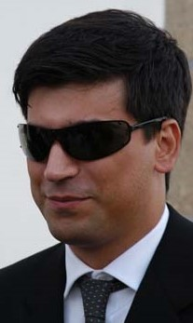
Who Am I Let’s OSINT me ☺
Just got a name
Pedro António Oliveira Vieira
Google (link)
Google “Improved Search” (link)
LinkedIn (link)
Public profile was showing way too much
Certified Ethical Hacker (link)
Notes:
Positive/False Results
Google
Positive/
Linkedin
Location
Studied
Interests
“Friends”

Slide 9
Who are YOU Search yourself
Search your name on Google and analyze the results
As you saw the search can be improved
Some results can/will include:
Friends
Work
School grades
BI - Identity Card Number (yes)
NIF – Tax Identification Number
That is typically information to verify your identity over a phone call.
Notes:
Positive/False Results
Google
Positive/
Youtube
Account PAOV1976
Subscriptions (Interests, Friends)
Subscribers (Friends ?)
Linkedin
Location
Studied
Interests
“Friends”

Slide 10
Search Engines Internet is more than Google
Different search engine → different rules/crawlers → different results
Google (link)
Bing (link)
Yahoo (link)
Ask (link)
DuckDuckGo (link)
Baidu (China) (link)
Yandex (Russia) (link)

Slide 11
Google Dorks Commonly used searches
Google Advanced Search (link)
Google Hacking Database (link)
gbhackers (link)
google-dork-list (link)
Google Guide (link)
Google Guide (link)

Slide 12
Search operators Improve the search
filetype: search your results based on the file extension
cache: This operator allows you to view cached version of the web page.
allinurl: This operator restricts results to pages containing all the query terms specified in the URL.
inurl: This operator restricts the results to pages containing the word specified in the URL
allintitle: This operator restricts results to pages containing all the query terms specified in the title.
link: This operator searches websites or pages that contain links to the specified website or page.
info: This operator finds information for the specified web page.
location: This operator finds information for a specific location.
42 Advanced Operators (link)

Slide 13
Search Dork Examples
Google Search (link)
Don’t open links just because they are available. It’s like entering a house just because the door was open. Would you do that ?
recibo vencimento filetype:pdf
recibo - keyword to look for
vencimento - keyword to look for
filetype:pdf - only pdf files
Available information on receipts
Full name, address, nif, nib, marital status, children number, ...

Slide 14
Search Dork Examples
Google Search (link)
“hacked by” site:pt
“hacked by” - keyword to look for
site:pt - only “portuguese” sites (registered portuguese domains)
About 13.400 results
Sites / pages that were “tagged”/”signed”
Attack and contents changed to show off skills (mainly kids) – compared to street tagging

Slide 15
ONLINE SAFETY

Slide 16
Helping Tools Safety
VirusTotal
Check received files (link) (don’t upload Personal or Company related information)
Netcraft
Sitereport (link) (check for suspicious sites)
Credit Card (online shopping)
Virtual Card
Mbnet
Revolut
PayPal

Slide 17
Helping Tools Privacy
VPN
ProtonVPN, …
Temporary Email (Need to register?)
10 minute email (link)
20 minute email (link)
Disposable Email
60 minute email (link)
Internet Access (DarkWeb included)
Tor (link) (internet browser)
Tails (link) (OS that runs on usb or VM)

Slide 18
Helping Tools Reverse Tracking
Gmail Plus Address (link)
Example:
mypersonalemail@gmail.com
If you append a “plus” sign to your email username, Gmail will ignore anything written between the + and @ sign in the email address and still deliver the message to the same mailbox.
any email address sent to
mypersonalemail+linkedin@gmail.com
mypersonalemail+continente@gmail.com
mypersonalemail+financas@gmail.com
Will still reach the Gmail inbox of mypersonalemail@gmail.com inbox though, technically, they are three different email aliases.

Slide 19
Passwords / Credentials Please don’t share
Kaspersky
Check your password (link) (or maybe not)
Check last name – “vieira” or “Vieira” or “Vieira123”
Top 10 passwords
“qwerty”, “password”, …
Country specific: BR example “password” → “senha”
Daniel Miessler SecLists
Usernames (link)
Passwords (link)
Default Credentials (link)

Slide 20
OSINT

Slide 21
OSINT Personal Information
Posted information can get publicly and world available
Even private profiles can have their data shared by others
When information is posted
Shows where you are at that time (habits & routines)
Information on the picture
Metadata
Geolocation
What companies know about us (link)
Awareness
What do we teach our kids? Do we teach ?
They are exposed to everyone on the internet.

Slide 22
Awareness True stories
Someone posted a photo of healthy meal
Laptop in background: Zoomed in and read emails
Social Media uses OCR. They also read the emails
I once posted picture on social media while on trip
My friends knew I was not home (Not public profile. At least I think it is not)
Friends on that location called me on the phone
Buying book (Buyer’s card information)
How I was able to get money just by having the right information
Social Media accounts
If you don’t have Facebook, I can create one in your name and call your friends

Slide 23
Deadly Social Media The Final Hours of Pop Smoke
Rapper Pop Smoke Murdered in Home Invasion ... By 4 Masked Gunmen (link)
Instagram Posts
Location Tag
Geolocation
Reverse Image
Google Maps
Local Recon
Airbnb/Zillow (Rent/Real-estate)
House photos (Outside and Inside)
Layout
YouTube Video: The Cyber Mentor (link)

Slide 24
OSINT Tools & more tools
OSINT FRAMEWORK (link)
Yups, only one link is enough

Slide 25
OSINT Profiling
What’s my IP? (link)
Ip2Location (link)
Mylocation (link)
Twitter
Twitter Advanced Search (link)
Facebook
StalkFace (link)
Sowdust Github (link)
IntelligenceX Facebook Search (link)

Slide 26
OSINT Profiling
Mobile (how long have you been using the same number)
Sync me (link)
Usernames (you reuse usernames)
NameChk (link)
WhatsMyName (link)
NameCheckup (link)
Tinder
Username reuse (link)
New tools are always being created

Slide 27
OSINT Profiling - Professional
LinkedIn (link)
Xing (link)
Company Information
Technologies described in job adds (leaking information)
Professional information phishing
Fake job adds (Is this a thing?)
Curriculum Vitae
Sending CV with too much information – what is too much ☺
Home address – Street View

Slide 28
OSINT PT

Slide 29
OSINT Portugal – Public contracts
Base (link)
The example (link)
PDF of contract with PII strikethrough (link)
Open with pdf reader and delete the strikethrough boxes
Name of employee who edited the document
Information on UA, LinkedIn, Facebook, …
Metadata: “KONICA MINOLTA bizhub C454”
Information leaked
Full Names, nif, addresses

Slide 30
OSINT Portugal – Vehicle Information
Automóvel On-line (link)
Certidão Permanente Automóvel (link)
License Plate : “01-EF-34”
Result
Brand: MERCEDES-BENZ
VIN: WDD2040081A043326
Example (link)
Vehicle Information (link)
Example (link)
Information: Brand, Model, Location, Paint, Delivery Date, Extras, …
Hack across the globe by VIN (link)

Slide 31
OSINT Portugal –Insurance Information
ASF – Autoridade de Supervisão de Seguros e Fundos de Pensões (link)
Example (link)
License Plate : “01-EF-34”
Date : “03-07-2022”
Example 2 (link)
License Plate : “01-EF-34”
Date : “03-07-2012”
Insurance Company
Current and Past
Length of the contract
Insurance policy number
Can I get information for all license plates ????

Slide 32
OSINT Portugal Specific
Registo Predial Online (link)
DGES - Direção-Geral de Ensino Superior (link)
DRE - Diário da República (link)
Search DRE (link)
Finnaças - Penhorados (link)
Example (link)
Search Penhorados – (link)
Ministério da Justiça - Penhorados (link)
Plataforma Eletrónica de Compras (Administração Pública) (link)
Leaked information:
Full Names, Addresses, NIF, Company, Marital Status, …

Slide 33
OSINT GEO

Slide 34
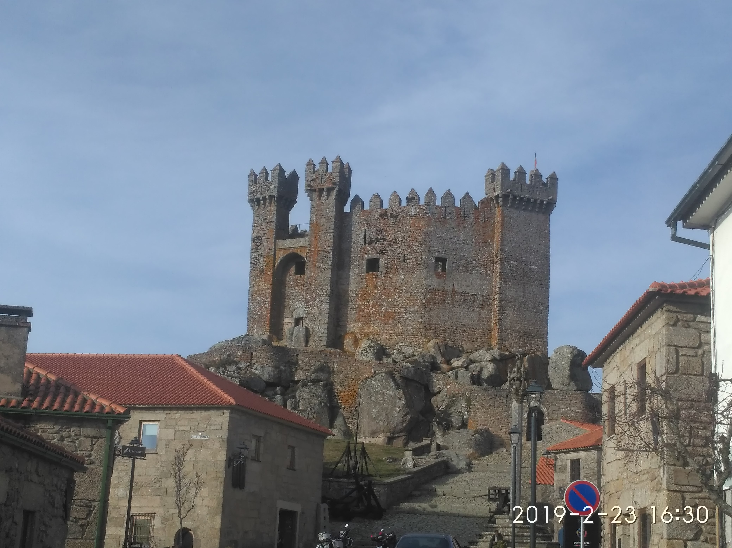
OSINT - Photos Lots of Information
Where was this image taken?
Have you been there?
When?
Date stamp on photo
Filename with date
Metadata
What else?
Image search
Identify the castle?

Slide 35
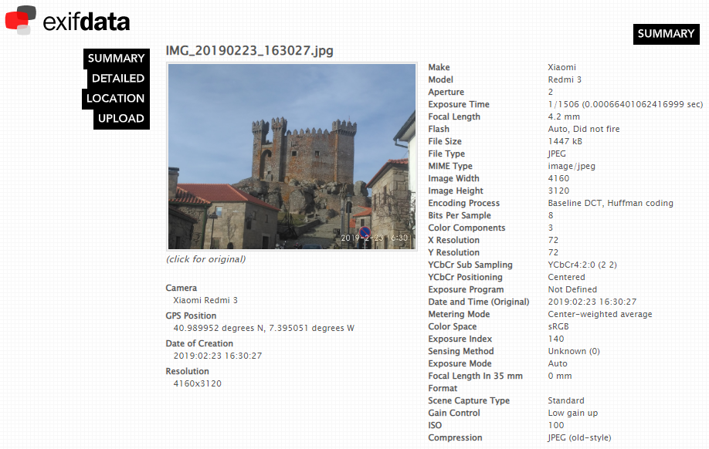
OSINT - Photos Metadata
Metadata
GPS (link)

Slide 36
OSINT (Reverse) Image search
One image is worth 1000 words, maybe more.
What information can be extracted from a photo ?
Google Images (link)
Bing Images (link)
Yahoo Images (link)
Tineye (link)
Yandex (link)
The professionals (video explaining) (link)

Slide 37
OSINT Street View
Google Street View (link)
Identify house by address
Assess security (cameras, fences, ...)
Parked cars (timeline, ...)
People’s habits/routines, timetables, ...
View the past – timeline (link)
Instant Street View (link)

Slide 38
OSINT Maps
Google Maps (link)
Bing Maps (link)
Wikimapia (link)
Tips, Tricks and Techniques (link)

Slide 39
Search Satelite View
Zoom Earth (link)
Satellites Pro (link)
World Imagery (link)
Wayback (link)
Wayback example (link)
View the past - timeline

Slide 40
Search Geolocation
Digital Cameras/Mobile Phones
Metadata
Geolocation
Camera Model
…
Breasts lead to arrest of Anonymous hacker (link)
Police allege that an Anonymous hacker posted a picture of his presumed girlfriend's breasts as a taunt to U.S authorities. The picture allegedly contained GPS information that led the FBI to her.

Slide 41
OSINT MEMORY

Slide 42
Wayback Machine Internet in the past
Wayback Machine (link)
Archive.is (link)
Cached Pages (link)
Cached View (link)
OldWeb.Today (link)
Time Travel (link)

Slide 43
OSINT IOT

Slide 44
Shodan Internet of Things
Search Engine for Internet Of Things
Explore
Shodan explore (link)
Images
Shodan images (link)
Maps
Shodan maps (link)
Internet Exposure Observatory
Exposure Dashboard (link)

Slide 45
Shodan Internet of Things
Remote Desktop (link)
Total results: 3,482,756
Braga (link)
Images
Braga (link)
VNC Remote Access and Loggedin (link)
Authentication Disabled
Portugal (link)
Primavera (link)
Contabilidade (link)

Slide 46
Shodan Internet of Things
Fotos
Portugal (link)
IP Cameras
Portugal (link) (default credentials?)
Webcams (link)

Slide 47
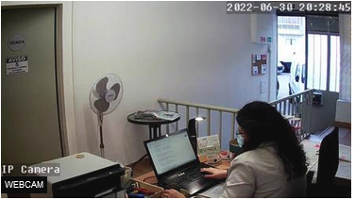
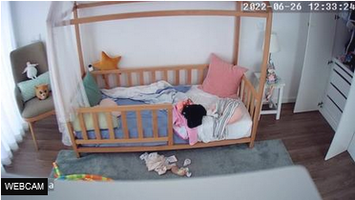
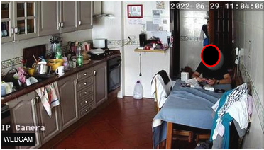
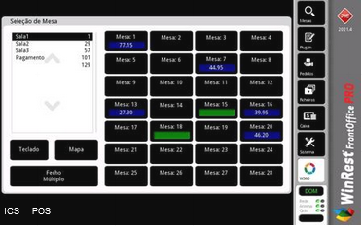
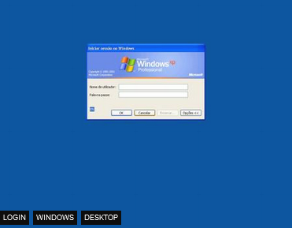
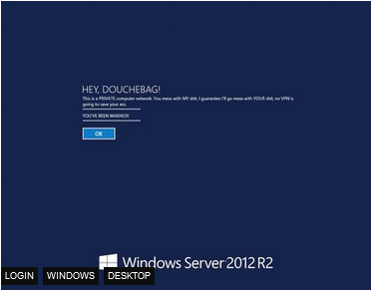
Shodan Internet of Things - Images

Slide 48
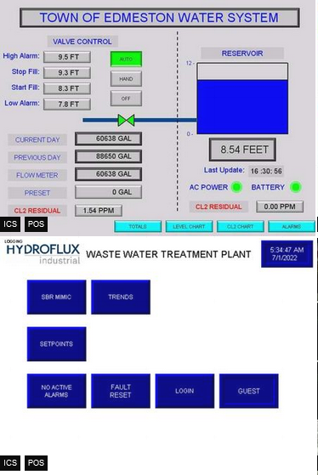
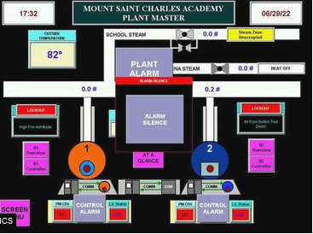
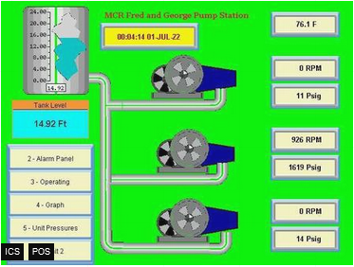
Shodan Industrial Control Systems
Industrial Control Systems (link)

Slide 49
Shodan Portugal – Internet Exposure
Internet Exposure Dashboard (link)
Top Vulnerability
CVE-2015-0204 – CVSS2 4.3 Medium (link)
BlueKeep Unpatched (link)
107 (link)
Industrial Control Systems
516
SMB (shared folders)
Authentication Disabled: 2898

Slide 50
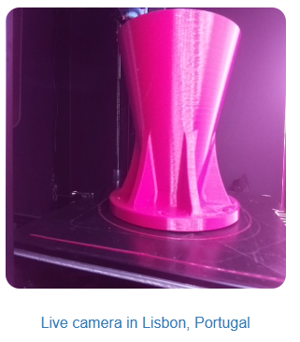
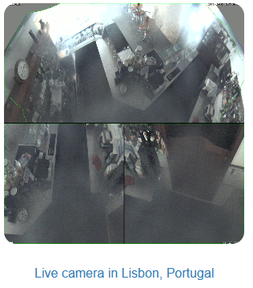
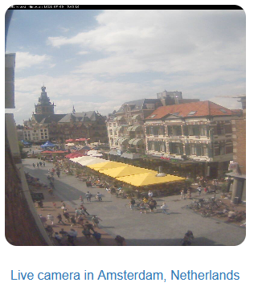
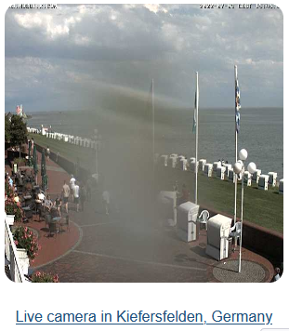
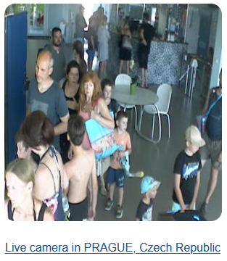
Insecure Insecure Cameras
Browser edit (link)
Portugal (link)

Slide 51
Databreach

Slide 52
Databreach Is not a thing of the past
Troy Hunt
HaveIBeenPwned (link)
Pwned websites (link)
Ashley Madison Breach 2015 (link)
When private data gets public
Piracy - Subtitles
Don’t think you can hide – Illegal activities are tracked
Companies are leaking all your information
Compromised data: Dates of birth, Email addresses, Employers, Family structure, Genders, Income levels, Living costs, Marital statuses, Mothers maiden names, Names, Phone numbers, Physical addresses, Places of birth, Religions, Spouses names

Slide 53
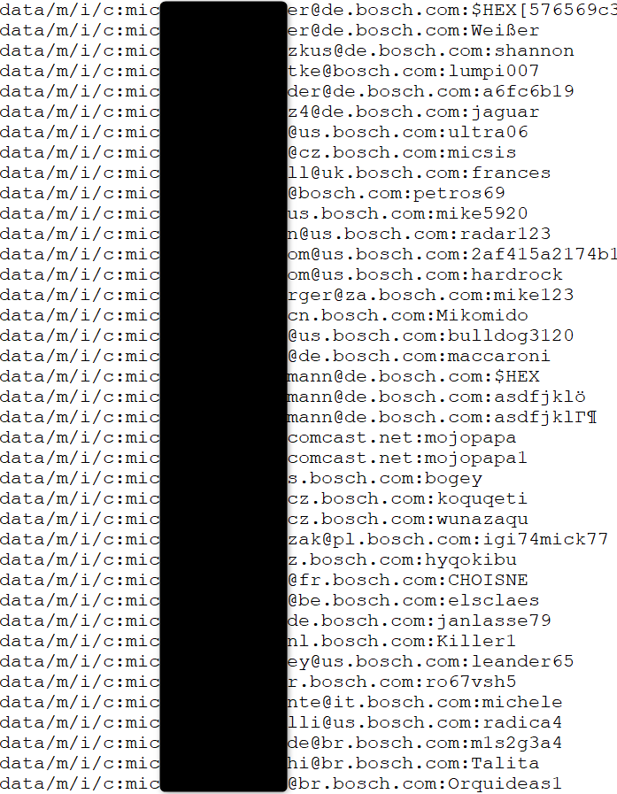
Databreach Company credentials ?
Email/Login
Password
Source
Publicly available list of credentials
More than 10k credentials just for Bosch
Information gathered
Rule of email/login
(FirstName.LastName)@(Country).(company).com
Rule of password complexity
List of users
Phishing campaigns
Brute force
Look for those users on Social Media
Added Problem
Credentials reuse

Slide 54
Databreach Portuguese domain examples (2018)
uminho.pt - Universidade do Minho
adv.oa.pt - Ordem dos Advogados
pj.pt - Policia Judiciária
mail.exercito.pt - Exército
cm-braga.pt - Câmara Municipal de Braga
cm-guimaraes.pt - Câmara Municipal de Guimarães
psd.pt - Partido Social Democrata
ps.pt - Partido Socialista
fcporto.pt - Futebol Clube do Porto
min.justiça - Ministério da Justiça
Were these the sources for criminal “hacker” Rui Pinto ?

Slide 55
Wifi

Slide 56
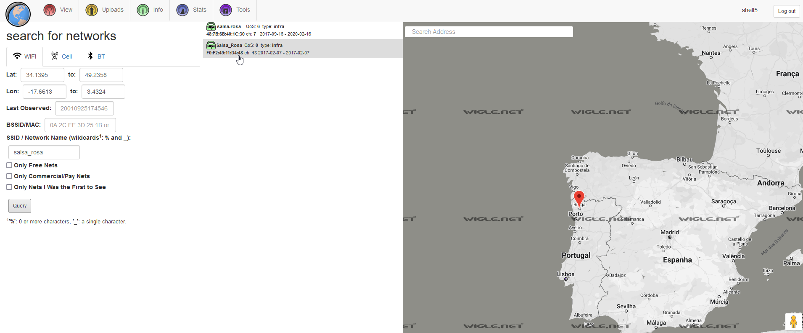
Wifi World Map - WiFi Networks
Wigle – shell5
https://wigle.net/map?maplat=41.53443897842117&maplon=-8.437174307569958&mapzoom=21&coloring=density
mac address lookup
https://dnschecker.org/mac-lookup.php?query=68-cc-6e-c0-c7-e1

Slide 57
Hacker Mentality

Slide 58
Penetration Test Portugal – Ministério da Justiça
How safe is our information?
Site URL: https://www.automovelonline.mj.pt/AutoOnlineProd/
Is there a DEV site?
Error shows software and version (Apache Tomcat/8.0.41)
Are there exploits? Exploit Database (link)
Automatic testing website (link)
Are these tests legal?
If you don’t own the site, it’s usually not legal or allowed.

Slide 59
Capture The Flag

Slide 60
CTF Capture The Flag
TryHackMe - https://tryhackme.com/
HackTheBox - https://www.hackthebox.eu/
VulnHub - https://www.vulnhub.com/
OTW - https://overthewire.org/wargames/
PicoCTF - https://picoctf.org/
CryptoPals - https://cryptopals.com/
CryptoHack - https://cryptohack.org/

Slide 61
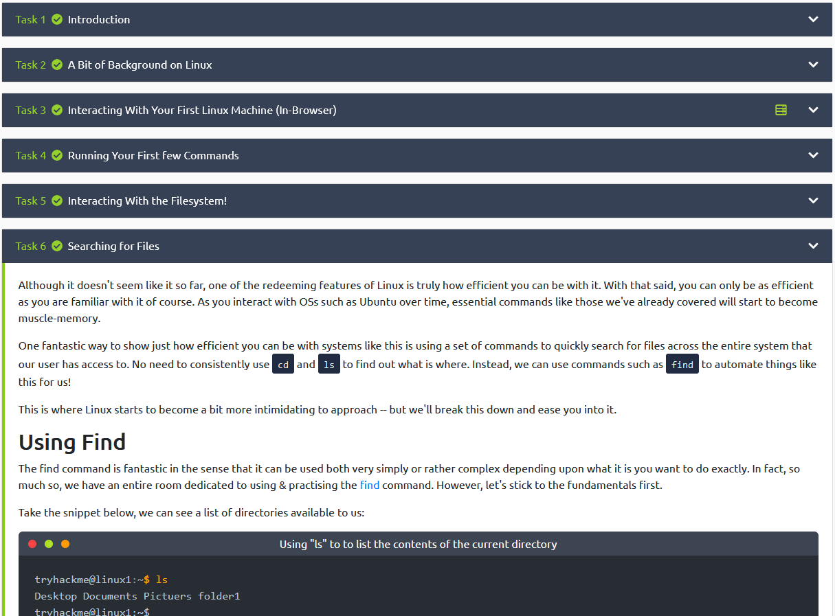
CTF THM – Try Hack Me
Try Hack Me (link)
TryHackMe is a free online platform for learning cyber security, using hands-on exercises and labs, all through your browser!
Learn
Our content is guided with interactive exercises based on real world scenarios, from hacking machines to investigating attacks, we've got you covered.
Practice
Put your knowledge into practice with gamified cyber security challenges.
Cost – Free or $10/month

Slide 62
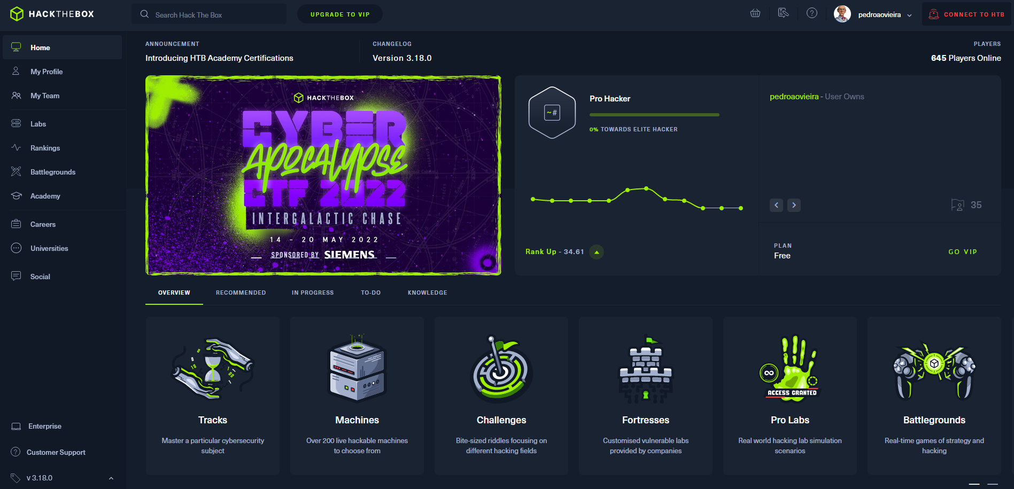
CTF HTB –Hack The Box
Hack The Box (link)
Hack The Box is a massive, online cybersecurity training platform, allowing individuals, companies, universities and all kinds of organizations around the world to level up their hacking skills.
Challenges
Hardware, Crypto, Pwn, Mobile, Reversing, Web, …
Machines / Tracks
Cost – Free / €12/month
Job Board

Slide 63
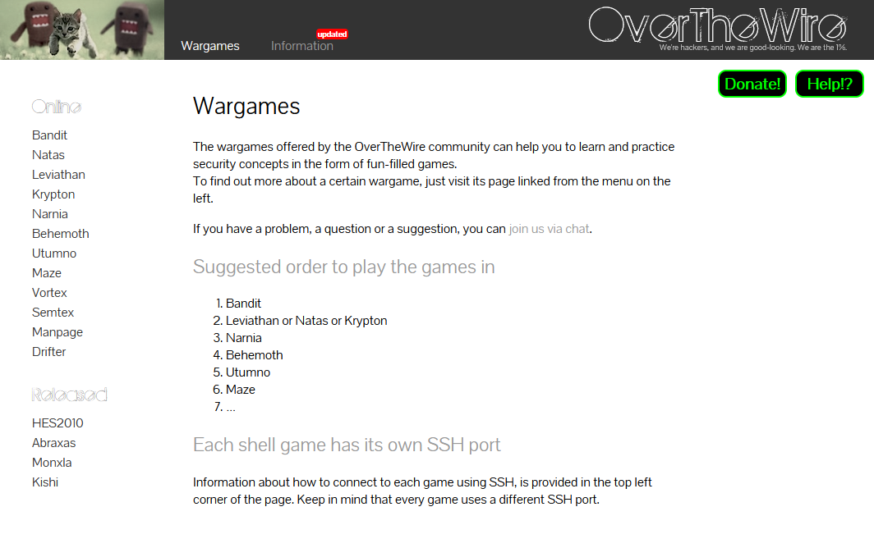
CTF OTW –Over The Wire
Over The Wire (link)
Linux and Web based games
Linux - Bandit
Web - Natas

Slide 64
License
Feel free to use/modify/share
teach

